Slide 1
Spin A Yarn
Creative Writing

Slide 2
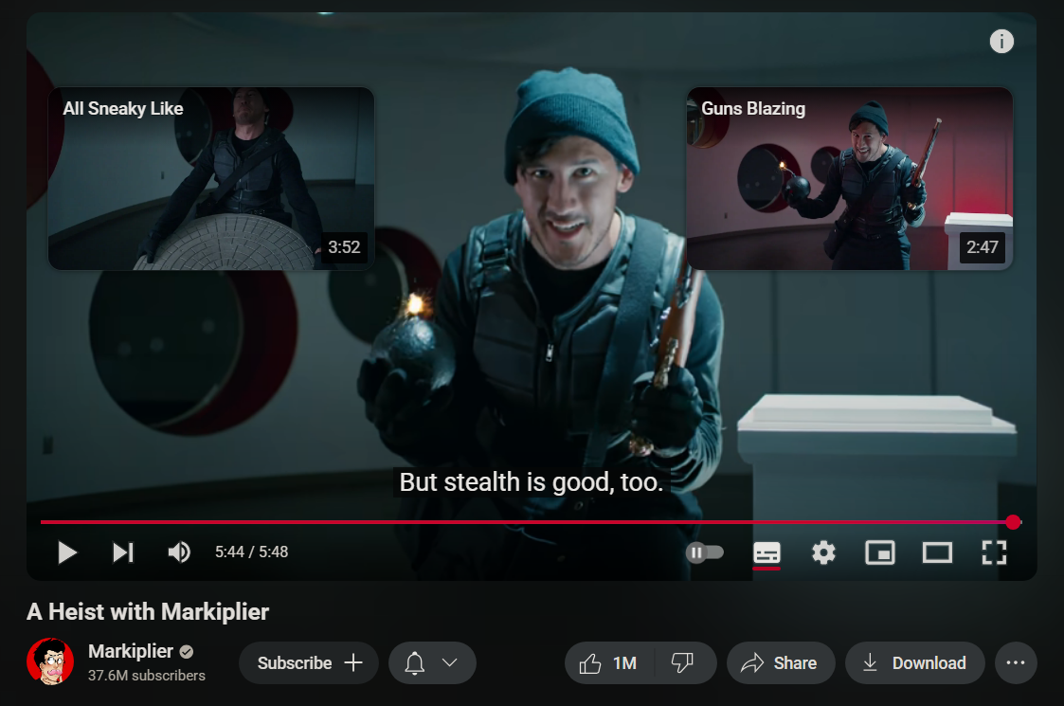
The world of creative writing is bigger than you might think!
What different ways of telling a story can you think of?
I’ll give you an example: YouTube videos!
Notes:
More examplessssssssssss :0 books, short stories, tv shows, video games, board/tabletop games, poems (spoken word + written), dance, plays, music, short form videos (for example the backrooms!), illustrations

Slide 3
Falmouth University has three writing courses:
BA (Hons) Creative Writing
BA (Hons) English & Creative Writing
BA (Hons) Journalism & Creative Writing
BA (Hons) Game Development: Writing
If you are interested in English or Journalism, you can take our courses that offer a balance of classes dedicated to learning those subjects alongside creative writing classes. Similarly, if you want to focus on learning about game development and narratives, we have a dedicated course in our Games Academy to specialise in writing for games!
Each course has access to the Lighthouse, a designated cosy study space, and the Newsroom.

Slide 4
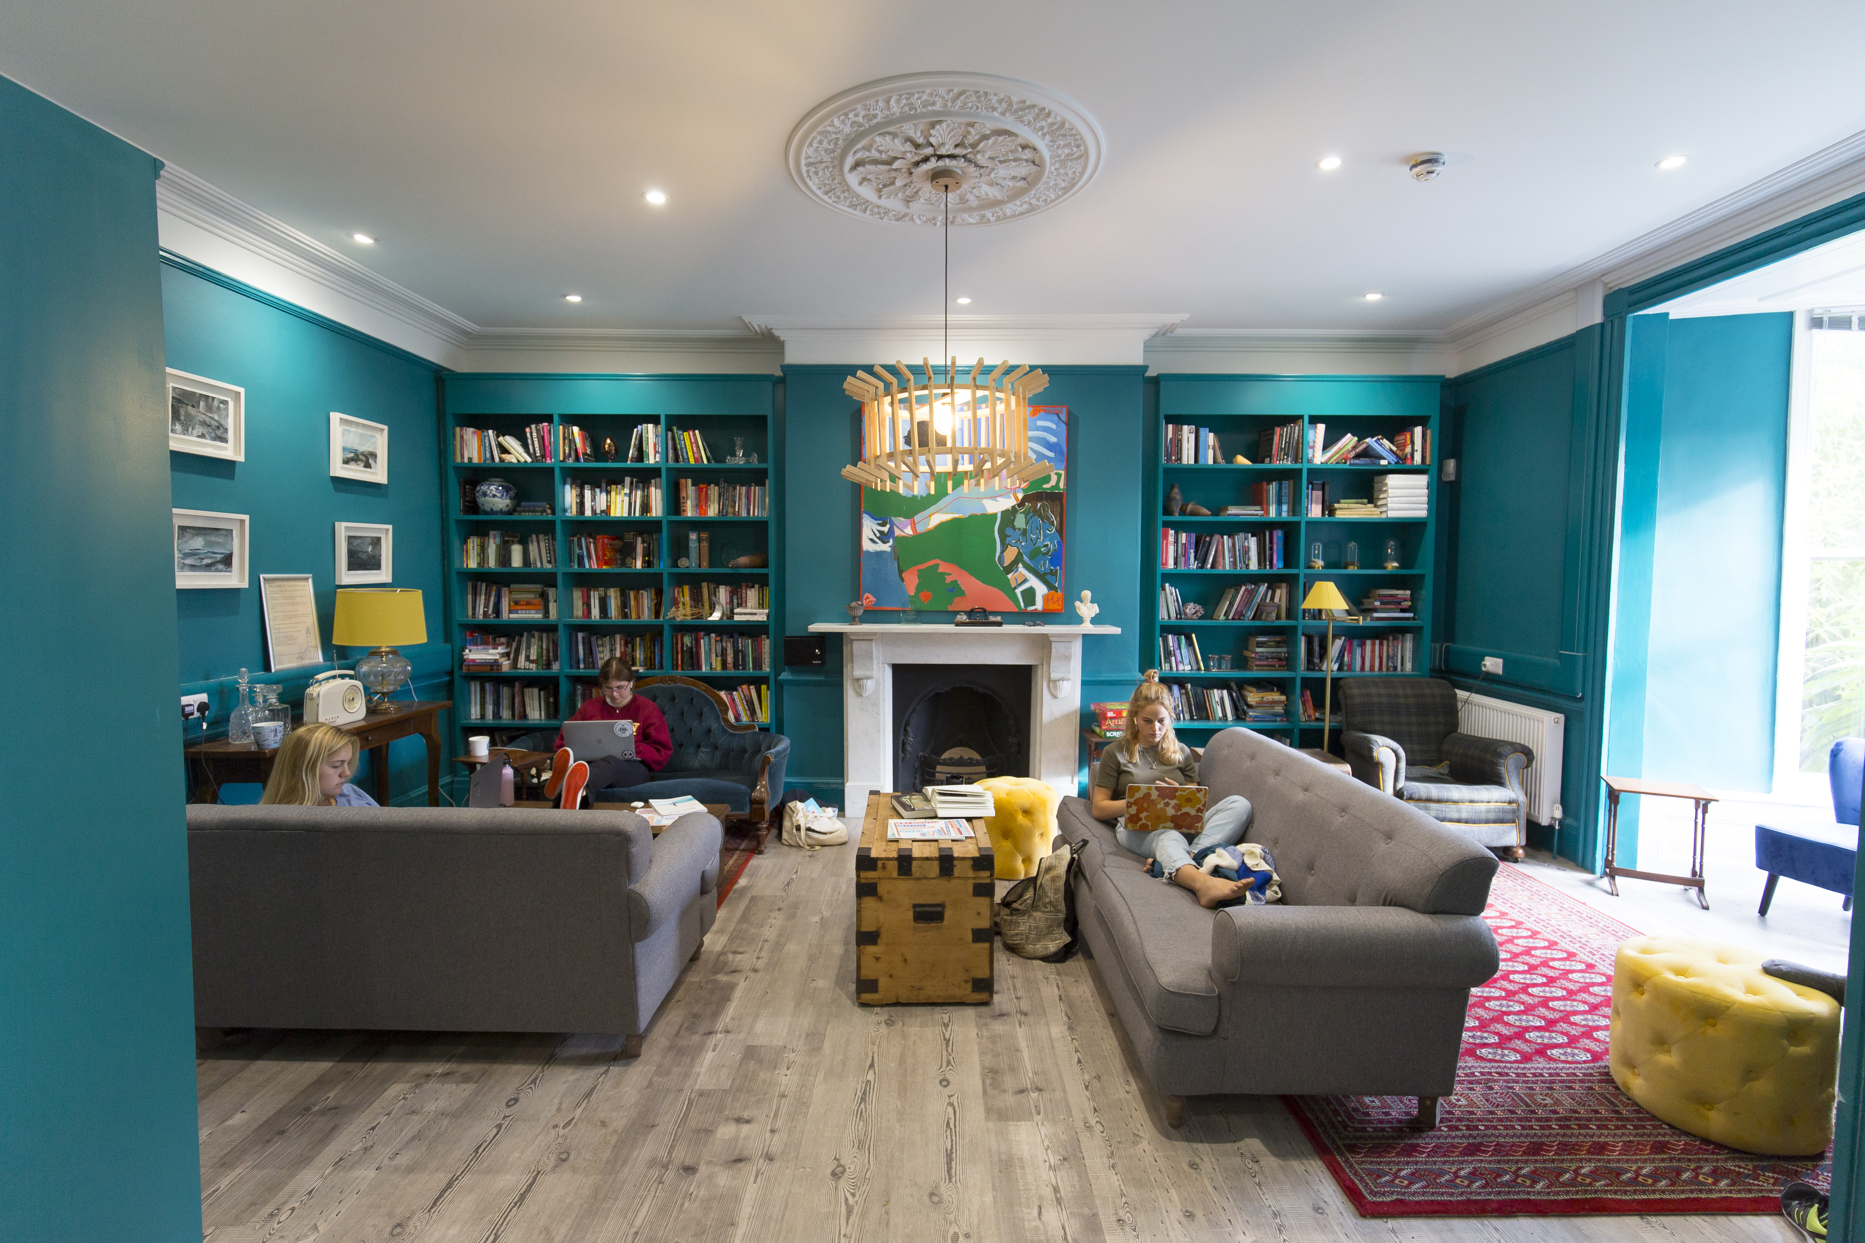
The Lighthouse
A very cosy space on Falmouth Campus just for people on a writing course!

Slide 5
You know what’s so great about creative writing…
Everyone can do it!
Notes:
Mention like skill level, don’t need “fancy” words, everyones ideas and stories are unique to them! All they need is a way to get their story outside of their brains.

Slide 6
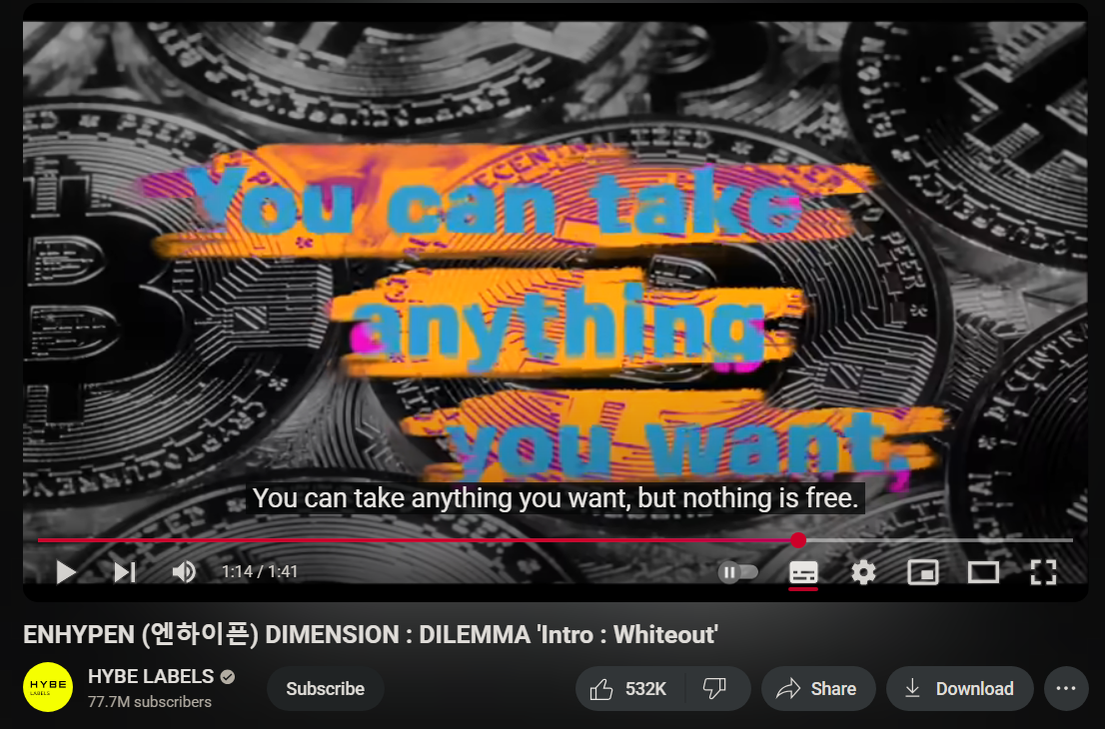
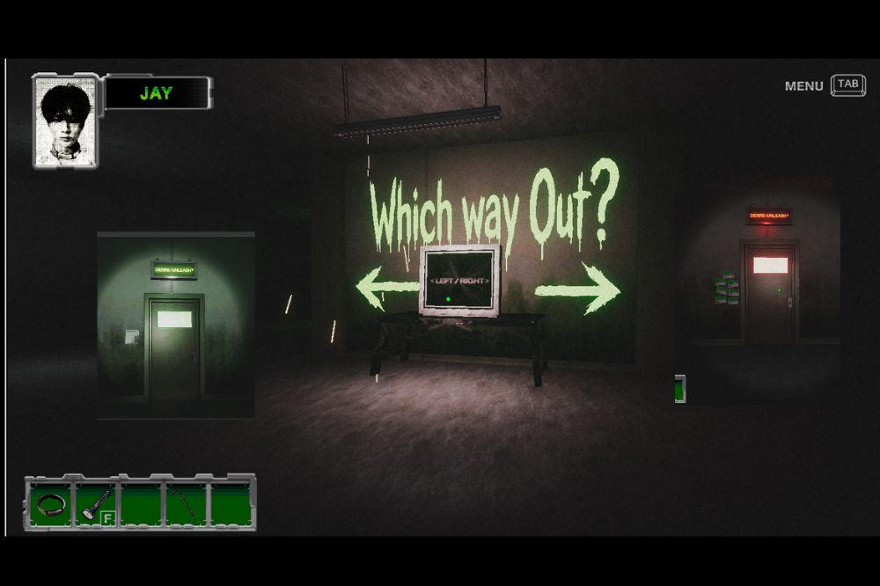
Even bands like to experiment with different types of creative writing!
One of my favourite bands has intro/outro narration for their albums that tell you a piece of their story.
Enhypen also made a point and click escape game where players had different options to choose from to promote their latest album this year.
Notes:
Had 2 plug the boys yk how it be

Slide 7
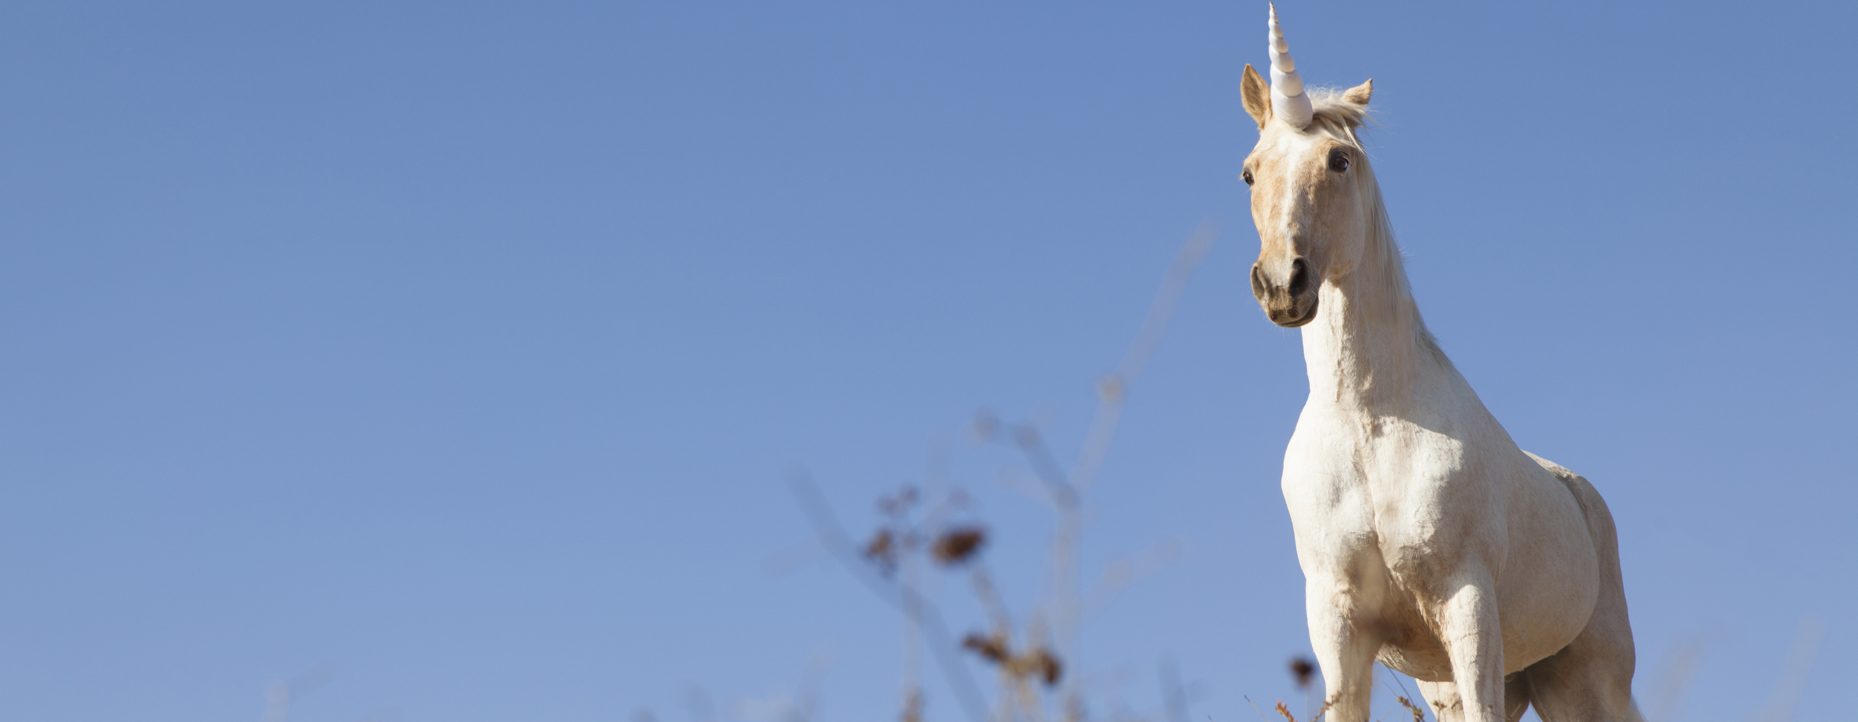
Time to create a story together!!!!
We are also going to be making “choose your own adventure” stories. Using a tool called “Twine” which you can use for free in your web browser!

Slide 8


Using Twine
Open Twinery.org and click 'Use in your browser'
Create a new story using the 'New' button on the top left

Slide 9
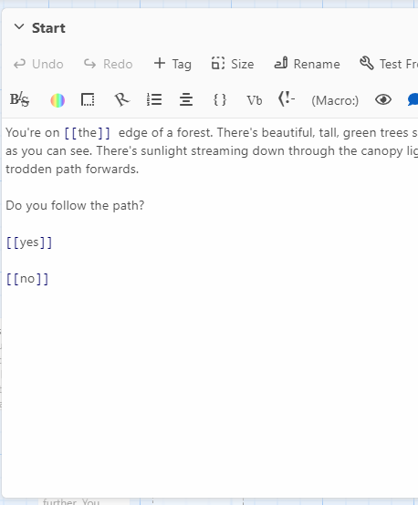


How DO I use this?
All parts of your story are called 'Passages'. You start with one passage. This will be the start of your story!
To create a new passage, you use two sets of square brackets in your current passage, like in the picture.
This will then create a new passage for you to fill. (On an ipad you need to click “Edit” on the top bar after clicking the passage you want to edit)
Notes:
Now we're going to walk through this together so that you've got the basics down before you go off and create your own stories.

Slide 10
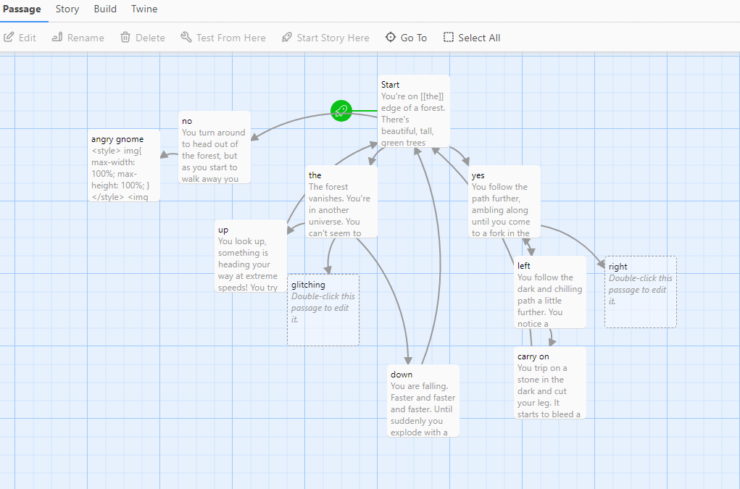
Once you have a few passages your story will start to look more like this.
You can also link back to your starting passage (maybe there’s ways to get a “game over”)

Slide 11

Time to write your own story!!
Now you’ve gotten used to it… It’s time to use your new Twine skills to put together a 'Choose your own adventure' type story.
Here’s a challenge for you. We have 3 different elements that you must include in your story: a genre, a theme, and a surprise element!
Be as imaginative and adventurous as you can!
Notes:
Give at least 20 minutes for story creation and go round checking in on progress. Check on story content along the way.

Slide 12
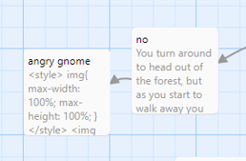
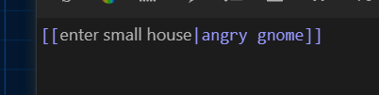
ToP Tips
To link to a pre-existing passage, use the title you can see in the map!
You can change the title of the next passage to be whatever you like to help keep track. For example, in this map , one is called “angry gnome” but if we don’t want the player to see angry gnome and instead see the choice to “enter small house,” we add one of these “|” in the middle.
To test-run your story at any point press 'Build' in the menu and then press 'Play’
Don’t be afraid to ask for us for the instructions again if you need them!

Slide 13
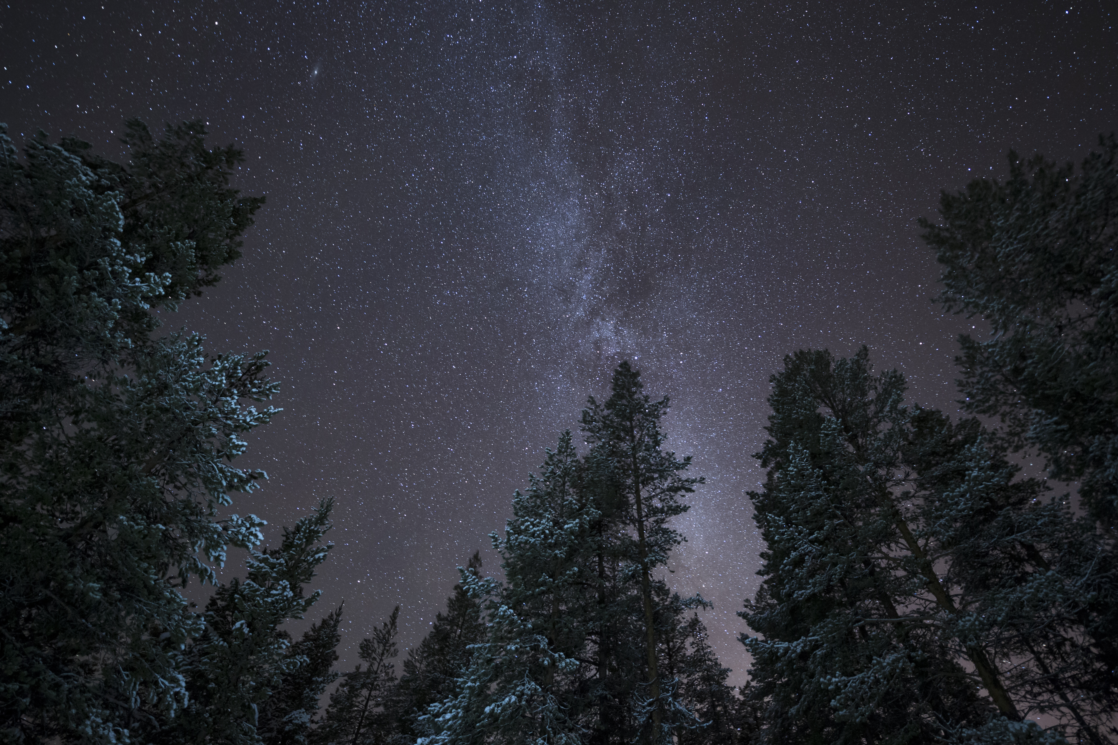

Now let’s add some visuals!
Find an image on google that you want to add that relates to your story
Right click on the image and choose 'Copy link'
Paste the link into the code where it says "Put image url here"
The code you need:
<style> img{
max-width: 100%;
max-height: 100%;
}
</style>
<img src="Put image url here">
</div>
Notes:
To change the size you just need 2 change the %s

Slide 14

Let's play some stories!
Notes:
Yippeeeeee!!!!

Slide 15


